Slide 1
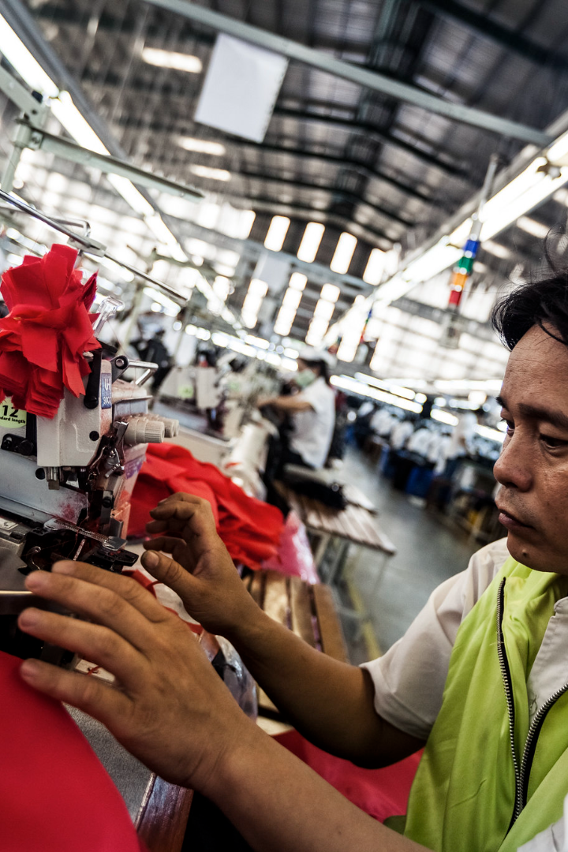
Weaving Insights: Understanding Garment Employee Productivity
In the garment industry, productivity is key. Our team has conducted an in-depth analysis to understand the factors that affect productivity and employee performance. Let's take a closer look at our findings.

Slide 2

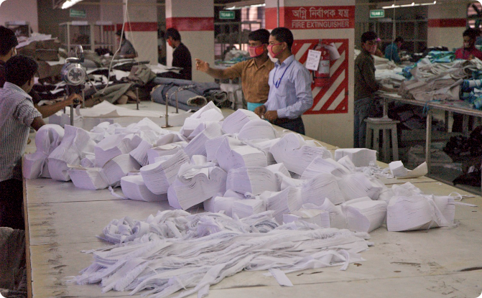
The Industry
Global Importance
Labour Dynamics
The garment industry is one of the largest sources of employment and revenue in developing countries.
The industry heavily relies on manual labour, making it a labor-intensive industry.

Slide 3

The Data
Data Period
The data was collected from December 2014 to October 2015.
Level of Observation
The data is observed at the quarter-department and department-productivity level.
Quality Control
We imputed the missing values and used the median value as a substitute in the WIP variable.

Slide 4
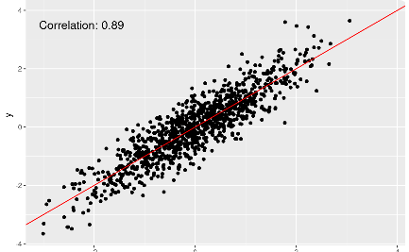
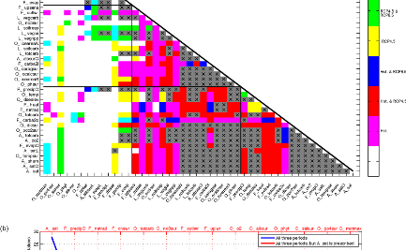
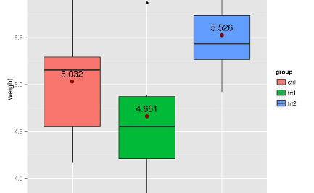
Exploratory Data Analysis (EDA)
Scatter Plot
Correlation Matrix
Box Plot
We plotted the data to identify any relationships between variables.
We used a correlation matrix to identify the strength of the relationships between the variables.
We also created a box plot to identify any outliers in the data.

Slide 5

The Model
1
Linear Regression
We used a linear regression model to identify the key variables affecting productivity.
2
Key Variables
The key variables we identified were incentives in Bangladeshi Taka (BDT), allocated minutes for a task, number of workers on a team, and amount of overtime in minutes.

Slide 6
Analysis
1
Incentives
We found that for each 10 BDT incentive increase, the model predicts an increase of approximately 2.95% in productivity. This shows that incentivizing employees can increase productivity.
Allocated Task Time
2
The model predicts that for each minute decrease in allocated time for a task, there is an increase of approximately 0.41203% in productivity. This shows that giving employees more time to complete tasks can improve overall productivity.
3
Team Size
According to the model, for each additional worker, there is an increase of approximately 0.32035% in productivity. This shows that having a larger team can improve overall productivity.
Overtime
4
Our analysis did not reveal a significant relationship between overtime and productivity.

Slide 7
Results
Increase in Productivity
Competitive Advantage
Employee Satisfaction
Based on our analysis, we can confidently say that our product will increase productivity in your garment business by up to 3%. This increase can translate into significant revenue gains for your business.
By using our product, you will have a competitive edge over other businesses in your industry. Improved productivity means faster turnaround times and higher-quality output.
Our product incentivizes your employees to work more efficiently, which can lead to increased job satisfaction and a higher retention rate.

Slide 8

References
Hasnat, S. (2023, November 8). Workers making clothes for top brands reject a proposal: $113 A month. The New York Times. https://www.nytimes.com/2023/11/08/world/asia/bangladesh-minimum-wage-protests.html
Productivity Prediction of Garment Employees. (2020). UCI Machine Learning Repository. https://doi.org/10.24432/C51S6D

